Slide 1
Indian Financial System, Financial Instruments, Financial Markets and Financial Institutions

Slide 2
Financial System
An institutional framework existing in a country to enable financial transactions
Three main parts
Financial assets (loans, deposits, bonds, equities, etc.)
Financial institutions (banks, mutual funds, insurance companies, etc.)
Financial markets (money market, capital market, forex market, etc.)
Regulation is another aspect of the financial system (RBI, SEBI, IRDA, FMC)

Slide 3
Financial assets/instruments
Enable channelising funds from surplus units to deficit units
There are instruments for savers such as deposits, equities, mutual fund units, etc.
There are instruments for borrowers such as loans, overdrafts, etc.
Like businesses, governments too raise funds through issuing of bonds, Treasury bills, etc.
Instruments like PPF, KVP, etc. are available to savers who wish to lend money to the government

Slide 4
Financial Institutions
Includes institutions and mechanisms which
Affect generation of savings by the community
Mobilisation of savings
Effective distribution of savings
Institutions are banks, insurance companies, mutual funds- promote/mobilise savings
Individual investors, industrial and trading companies- borrowers

Slide 5
Financial Markets
Money Market- for short-term funds (less than a year)
Organised (Banks)
Unorganised (money lenders, chit funds, etc.)
Capital Market- for long-term funds
Primary Issues Market
Stock Market
Bond Market

Slide 6
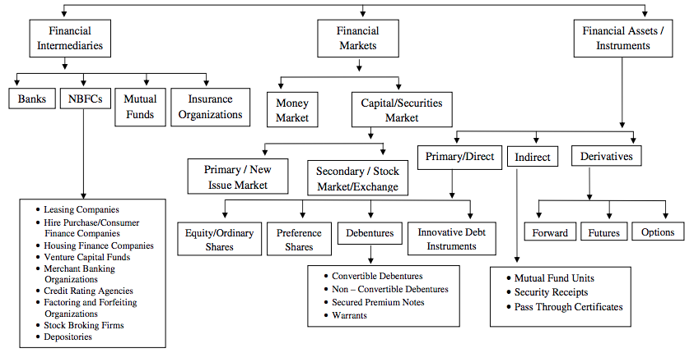

Slide 7

Financial Markets
Market?????
Financial Market is a place where financial assets are created or transferred

Slide 8
Classification
Financial Market
Money Market
Debt Market
Capital Market
Forex Market

Slide 9

Money Market
Markets for short term
Lending
Borrowing
Very short term maturity
Dominated by Government, Banks, Financial Institutions
Money Market Instruments - Call/Notice money market, Repo/Reverse Repo, Treasury Bills, Certificate of Deposits, Commercial Papers

Slide 10

Debt Market
Long term source of fund
Payment of principal & coupon
Supplements the banking system
Participants
Banks
Financial Institutions
Mutual Funds
Insurance Companies etc
Instruments
Government securities
PSU Bonds
Corporate Bonds

Slide 11

Capital Market
Long term source of finance
Raised by
Government
Corporates
Trading instruments used
Shares
Derivatives
Units of Mutual Funds
Consists of
Primary Market
Secondary Market

Slide 12

Foreign Exchange Market
Foreign Goods
Payments in Foreign Currency
Forex Market
Participants
Government
Payments for Imports
Repayment of Loans
Importers
Exchange Rates – One Currency in terms of other (Eg. 1 US Dollar = 70 Rupees)
Bid Price
Ask Price

Slide 13
Money Market Instruments
Certificates of Deposit
Commercial Paper
Inter-bank participation certificates
Inter-bank term money
Treasury Bills
Bill rediscounting
Call/notice/term money
CBLO
Market Repo

Slide 14
Certificates of Deposit
CDs are short-term borrowings in the form of UPN issued by all scheduled banks and are freely transferable by endorsement and delivery.
Introduced in 1989
Maturity of not less than 7 days and maximum up to a year. FIs are allowed to issue CDs for a period between 1 year and up to 3 years
Subject to payment of stamp duty under the Indian Stamp Act, 1899
Issued to individuals, corporations, trusts, funds and associations
They are issued at a discount rate freely determined by the market/investors

Slide 15
Treasury Bills
Short-term instruments issued by RBI on behalf of the government
They are auctioned by Reserve Bank of India at regular intervals and issued at a discount to face value. On maturity the face value is paid to the holder (at par)
The rate of discount and the corresponding issue prices are determined at each auction
They are like zero coupon bonds

Slide 16
Contd……
Any person in India including Individuals, Firms, Companies, Corporate bodies, Trusts and Institutions can purchase T- Bills
T-Bills are eligible securities for SLR purposes
T-Bills are available for a minimum amount of
Rs.25, 000 and in multiples of Rs. 25,000 thereafter

Slide 17
Contd…….
Presently T-bills have a duration of 91 days 364 days
91 day bills are auctioned every Wednesday
364 day bills are auctioned every second & fourth Wednesday

Slide 18
Investment Banking
Investment banks are financial intermediaries in the business of providing investment and financial advisory services to companies, governments and institutional investors

Slide 19
Investment Banking
Investment Banks
Issue securities on behalf of both private and public companies
Trade securities in the primary and secondary markets on behalf of both individual and institutional investors
Manage portfolios for High Net Worth Clients and Corporates
Provide financial advisory services to corporates, private equity groups, public entities, non-profit clients and institutional investors

Slide 20
Functions
Help public and private Corporates in issuing securities in the primary markets and acting as underwriters
Help the government in the disinvestment of public sector enterprises
Advice companies on M&A
Provide financial advice to investors

Slide 21
Investment Banking Services
Fund Raising Services
Initial Public Offerings (IPO)
Follow – on Public Offering (FPO)
Qualified Institutional Placements (QIP)
Rights Issue
Preferential Allotments
Foreign Currency Convertible Bonds (FCCB)
Global Depository Receipts (GDR)

Slide 22
Investment Banking Services
Advisory Services
Export and Project Finance
Mergers and Acquisitions (M&A)
Buy side advisory
Sell side advisory
Promoter and Acquisition Financing Advisory
Private Equity Advisory
Infrastructure Advisory

Slide 23
Investment Banking Services
Strategic Advisory Services
Debt Syndication and structured finance
Financial Restructuring and Turnaround Financing
Private Client services
Sales and Trading
Equities Research and Broking

Slide 24
Reserve Bank Of India Act-1934
RBI was established on 1st April 1935.
RBI was originally Privately owned.
RBI was Nationalised in Year 1949.
Central Office was initially established in Calcutta and moved to Mumbai in 1937.

Slide 25
Structure of RBI
RBI Have 20 Directors :
The Governor
Four Deputy Governors
One Govt. Official from Ministry of Finance.
Ten Nominated Director, nominated by Govt.
Four Directors to represent Headquarters at Mumbai, Kolkata, Chennai & New Delhi.
Appointed/ Nominated for period of Four Years.
RBI has Head office in Mumbai & other 22 regional offices.

Slide 26
Function of RBI
Bank of Issue
Banker to Government
Bankers' Bank and Lender of the Last Resort
Controller of Credit
Custodian of Foreign Reserves
Promotional functions

Slide 27
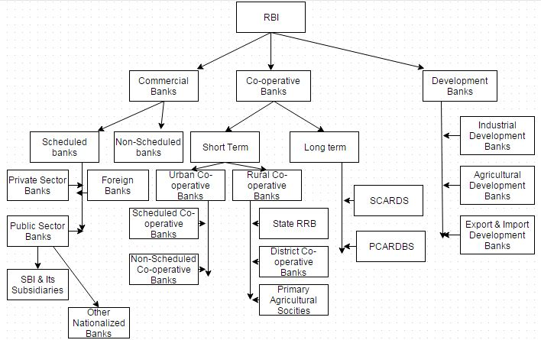

Slide 28

Equity Markets
Provided resources needed by medium and large scale industries.
Purpose for these resources
Expansion
Capacity Expansion
Investments
Mergers and Acquisitions

Slide 29





DIFFERENCE BETWEEN PRIMARY & SECONDARY MARKETS
Market Scope
Individuals want to invest in business
Companies want to raise money to expand their business
Primary Market
Company releases IPO. Individuals apply for IPO to obtain ownership of the company
Individuals apply to get Shares
Companies
IPO
Company allocate shares to individuals in lieu of investments
Secondary Market
Broker
Individual Investors
Companies
Companies get themselves listed on popular stock exchange like BSE and NSE

Slide 30
DOMESTIC OFFERINGS:
India Inc. raising funds by diluting their holdings through Initial Public Offerings/Follow on Offerings and get it listed on any Indian Bourses are called as Domestic Offerings.
INTERNATIONAL OFFERINGS:
When these shares (in form of Depository Receipts against it) are offered to European Investors and listed Stock Exchange [LSE/Luxemburg] in Europe, called Global Depository Receipts. When these Depository Receipts are targeted to American Investors and listed on American Stock Exchanges [NASDAQ], called American Depository Receipts or International Offerings.

Slide 31
What is a share / stock?
A type of security that signifies ownership in a corporation and represents a claim on part of the corporation's assets and earning
There are two main types of stock:
Common stock usually entitles the owner to vote at shareholders' meetings and to receive dividends.
Preferred stock generally does not have voting rights, but has a higher claim on assets and earnings than the common shares.

Slide 32
Market Capitalisation
No. of shares Outstanding * Market Price

Slide 33
INTERNATIONAL OFFERINGS
AMERICAN DEPOSITORY RECEIPT (ADR)
A security issued by a bank or a depository in United States of America (USA) against underlying rupee shares of a company incorporated in India.
GLOBAL DEPOSITORY RECEIPT GDR)
A security issued by a bank or a depository outside India against underlying rupee shares of a company incorporated in India.
ADRs/GDRs are issued on the basis of the ratio worked out by the Indian company in consultation with the Lead Manager to the issue.

Slide 34
American / Global Depository Receipts are in form of Depositary Receipts (DRs) as negotiable securities issued outside India by a Depository Bank, on behalf of an Indian company, which represent the local Rupee denominated equity shares of the company held as deposit by a Custodian Bank in India. DRs are traded in Stock Exchanges in the US, Singapore, Luxembourg etc. DRs listed and traded in the US markets are known as American Depository Receipts (ADRs) and those listed and traded elsewhere are known as Global Depository Receipts (GDRs).

Slide 35
A limited Two-way Fungibility scheme has been put in place by the Government of India for ADRs / GDRs.
Under this Scheme, a stock broker in India, registered with SEBI, can purchase shares of an Indian company from the market for conversion into ADRs/GDRs based on instructions received from overseas investors.
Re-issuance of ADRs /GDRs would be permitted to the extent of ADRs / GDRs which have been redeemed into underlying shares and sold in the Indian market.
The transaction will be effected through Securities and Exchange Board of India (SEBI) registered stockbrokers as intermediaries

Slide 36
What is a stock exchange?
A specialized marketplace that facilitates the exchange of securities that already exists
A stock exchange constitutes any body of individuals, whether incorporated or not , constituted for the purpose of assisting, regulating or controlling the business of buying , selling or dealing in securities
According to HASTINGS, Stock Exchanges or security market comprises all the places where buyers and sellers of stocks and bonds or their representatives undertake transactions involving the sale of securities

Slide 37
WHETHER YOU NEED AN EXCHANGE ?
You need an Exchange because of:
No Counter Party Risk
Pay-in & Pay-Out at Scheduled Time and as per Exchange Procedure
Consolidated Market – Fair Price

Slide 38
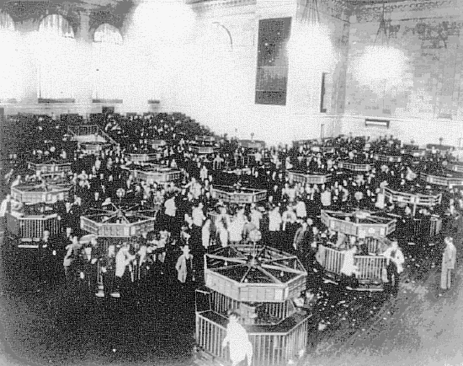

Traditionally, trading in Stock Exchanges in India followed a
conventional style where people used to gather at the
Exchange and bids and offers were made by open outcry.
1875 : "The Native Share and Stock Broker”
Association" (also known as "The Bombay
Stock Exchange”) was
established in Bombay
Bombay Stock Exchange played a pivotal role in the development of the Indian capital market
The Exchange has a nation-wide reach with a presence in 417 cities and towns of India.
BSE provides an efficient and transparent market for trading in equity, debt instruments and derivatives

Slide 39
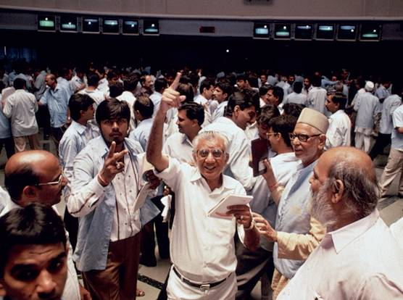

Slide 40









Equity Market in India
How can I Make more money – Where are the opportunities?
Before
Commission on Trade
(could vary on broker to broker)
Now
Charge Brokerage as per desire
Charge Brokerage – 2-4%
BROKER
Approach to buy Shares
Commission from mutual
fund companies ("trailer fees")
Misquote Prices
Customers
No Transparency
Management Fees (ie: if they manage your funds completely they would take a 1-2% yearly management fees as well)
Services Provided
Notes:
United States
While the term stockbroker is still in use, it is more commonly referred to as simply "broker", "registered rep" or simply "rep"-- shortened versions of the official FINRA (pronounced "FIN-ra") designation "Registered Representative". This designation is obtained by an individual passing the FINRA General Securities Representative Examination (also known as the "Series 7 exam") and being employed ("associated with") a registered Broker-dealer also called a brokerage firm; the firm is typically a FINRA "member" firm.
More restrictive FINRA licenses or series exams exist for brokers or reps who do not need the full array of capabilities with the Series 7. See the FINRA List of Securities Examinations. And variable products such as a variable annuity contract or variable universal life insurance policy typically require the broker to also have one or another state insurance department licenses.
United Kingdom
In the UK, brokers are required to pass the XII (Securities and Investment Institute) Certificate in Securities, this qualification is achieved by passing two exams: Either Unit 1: FBI Financial regulations or Unit 10 Principles of Financial Regulation for MiFID compliant retail trading, and either Unit 2: Securities, Unit 3: Derivatives or Unit 4: for both Securities and Derivatives. Passing Unit 10 or Unit 52 identifies individuals as having attained FSA Approved Person Status.
In 1995 there were 981 companies with revenues of $176.26 billion and 429,900 employees. In that year U.S. corporate stock and bond sales rose to $709.3 billion from $705.7 billion in 1994, due to a robust calendar of common-stock offerings. Behind the strong financing activity was a blend of lower interest rates and higher stock prices, which together spurred more and more individual investors to buy common stock. One of the most vibrant areas of the common-stock underwriting market was the initial public offering, as 572 companies came to market for the first time in 1995. Total debt sales, including convertible offerings, slipped to nearly $611 billion in 1995 from $628.8 billion in 1994. But asset-backed offerings jumped 42 percent to $107.1 billion.
In the past, investors had to call up their brokers and place an order on the phone. The broker would then enter the order in their system which was linked to trading floors and exchanges.
With the advent of the internet, investors can now enter orders directly online, or even trade with other investors via ECN's (electronic communication networks). Some orders entered online are still routed through the broker allowing agents to approve or monitor the trades. This step assists in the protection of both the client and brokerage firm from unlawful or incorrect trades which could affect the client’s portfolio or the broker’s license.
Online brokers are most often referred to as discount brokers, due to their lower fees as opposed to full service brokers who also give advice to clients.
Mumbai: : In technology terms, how are the two major exchanges of India—National Stock Exchange (NSE) and Bombay Stock Exchange—pitted against each other? Here’s a reality check.
The older of the two, BSE launched the electronic trading platform for the cash segment—BSE On Line Trading System (BOLT)—in 1995. For BOLT, BSE uses Tandem Fault Tolerant System consisting of 26 central processing units (CPUs). Tandem systems are high performance trading engines enabling huge volumes without any downtime. This electronic trading platform is available to members and their hierarchy through a nationwide network spanning over 360 cities, through over 7,000 trader work stations on campus LAN, leased lines and V-SATs for upcountry members.
According to the BSE spokesperson, the BSE Private Network in one of the largest and most sophisticated networks in Asia Pacific running multiple services from trading to settlement.
As against the BSE technology, the NSE trading system is implemented on the mainframe Continuum series of machine, which is supplied by Stratus Computers. The Stratus machines provide hardware-fault tolerance and therefore are able to sustain any single point failure. The operating system offers transaction protection, robust inter-process communication and network interface.

Slide 41






NEAT BOLT Launched - in 1995
Depository services launched in 1996
More Transparency
BROKER
Information Access
Information Access
Information with the Broker & the Customer is the same
Customers
Stock Exchange
Terminals

